Slide 1
Information Server suite-Quality Stage
Notes:
IBM Confidential

Slide 2
Data Quality Challenges
Different or inconsistent standards in structure, format or values
Missing data, default values
Spelling errors, data in wrong fields
Buried information
Data myopia
Data anomalies

Slide 3
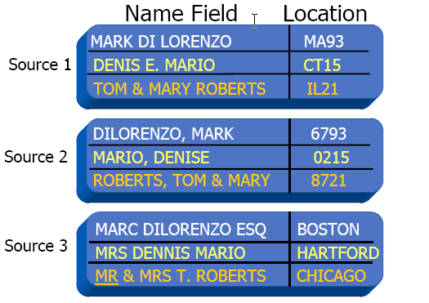
Different or Inconsistent Standards

Slide 4
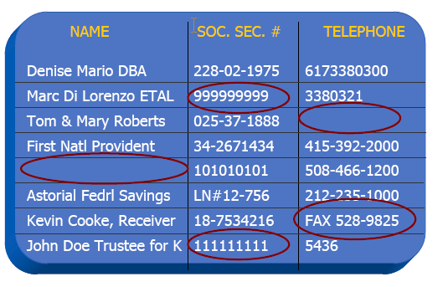
Missing Data & Default Values

Slide 5
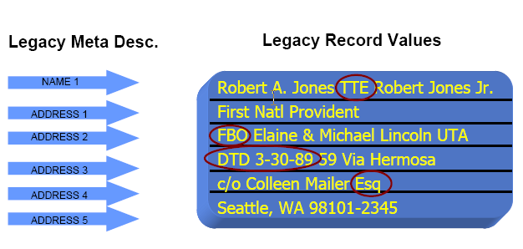
Buried Information

Slide 6
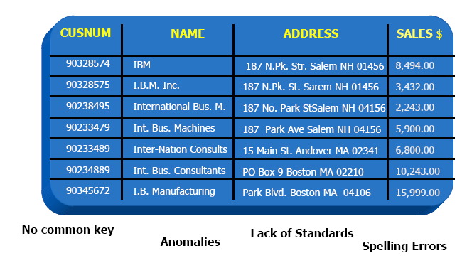
The Anomalies Nightmare

Slide 7
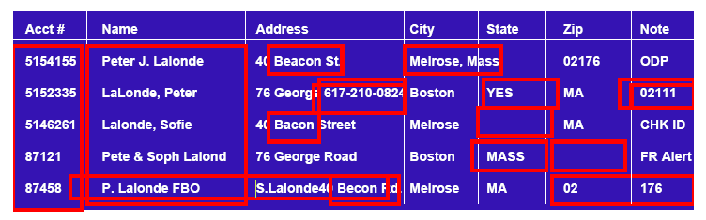
What data challenges do you face?

Slide 8
How does your organization define data quality?
Reports are accurate
􀂃 Data driven processes work correctly
􀂃 The mail reaches the correct person
􀂃 Shipments go out on time
􀂃 Invoices are accurate

Slide 9
Quality Stage Basics:
Ascential QualityStage helps you manage and maintain data quality
so that your company can rely upon its corporate data investment.
Helps organizations produce high-quality data as well as lower the
cost of data management.
IBM Quality Stage is a comprehensive development environment for developing applications that re-engineer data.
The aim of such an application is to deliver data that meets business requirements and successfully addresses business goals.
Data that is restructured to meet the new requirements is called re-engineered data.
Notes:
IBM Confidential
A re-engineering application caters to the following
Resolve conflicting and ambiguous meaning of data values.
Brings to surface important data hidden in free form text fields.
Standardizes data conforming to industry standards and government standards.
Creates a a unique view of a business unity.

Slide 10
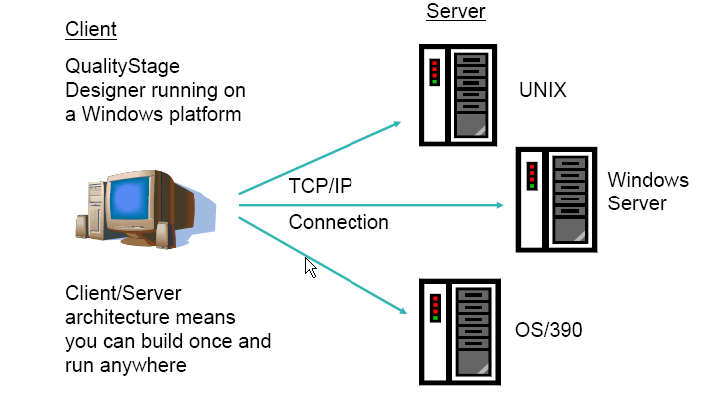
QualityStage Architecture
Notes:
IBM Confidential
Jobs are created using the Ascential QualityStage Designer defines how source data will be processed.
The Ascential QualityStage server accesses the source data, and processes them into the target re-engineered data.

Slide 11
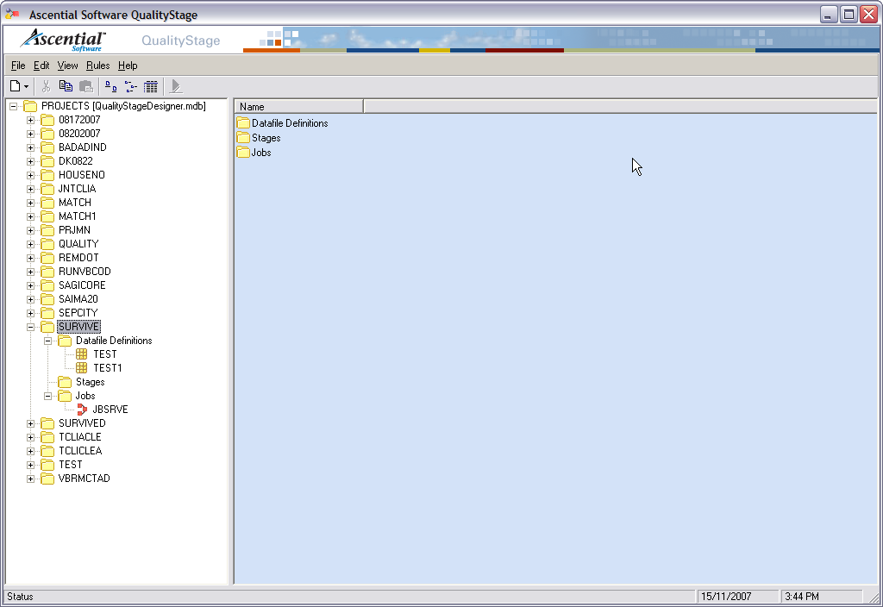
QualityStage Designer

Slide 12
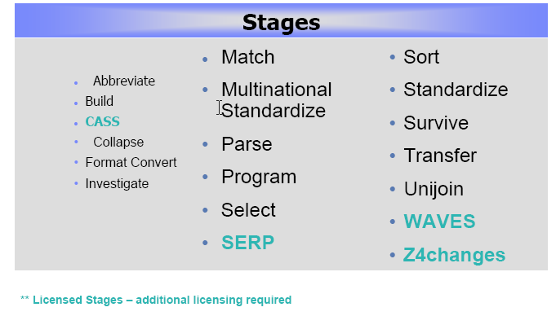
Stages in Ascential Quality Stage
Notes:
IBM Confidential

Slide 13

Data Re-engineering Methods
Notes:
IBM Confidential

Slide 14
Phase 1
Phase one deals with understanding the business goals and the way they define the requirements.
Understanding the business goals helps to understand the requirements and structure of the target data.
It also determines the quality of data the target needs in order to properly define the goals.
The complexity of the re-engineering application also depends on properly understanding the requirements and business goals.
Notes:
IBM Confidential

Slide 15
Phase 2
Phase two deals with understanding the structure and content of the source data.
This phase deals with preparing the data to be used with Quality Stage and also using Quality Stage to understand the content of the data.
Preparing the data means knowing the format of the data and also the data content like whether the data represents products or customers etc.
This helps in applying business rules all through the application. Data should be present in fixed length flat files that can be imported directly into Quality Stage.
Better understanding the data means investigating the data using Quality Stage.
Notes:
IBM Confidential

Slide 16
Phase 3
Phase three is the development phase of the re-engineering lifecycle which includes conditioning/standardizing, matching and survivorship of data.
Standardizing the input data means breaking up free form text fields into individual fields, correcting incorrect values, standardizing abbreviations etc.
While standardizing names appropriate name rules set should be applied, for addresses address rule sets should be applied etc.
Matching data means finding duplicate entries in the input file and establishing cross relationships between data in two files.
Survivorship of data means keeping all duplicate records, keeping just one record out of duplicates. Record retention is based on some formulas and also the format of the output record is defined.
Notes:
IBM Confidential

Slide 17
Phase 4
Phase four is evaluating the results.
It might be evaluating the results after each phase or evaluating the results after the preceding three phases.
Based on the evaluation the development lifecycle needs to be revisited at some phase and this process continues until the ultimate business goal is reached.
Notes:
IBM Confidential

Slide 18
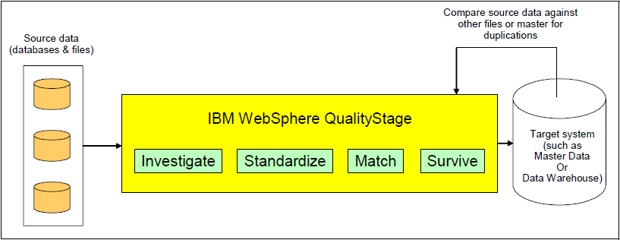
QUALITYSTAGE PROCESS OVERVIEW

Slide 19

WebSphere QualityStage Typical Scenario
Multiple databases and files
Compare source data against other files or master for duplications
Compare
Master Data
or
Data Warehouse
WebSphere QualityStage
Load unique data and discard duplicates
Source data
Notes:
IBM Confidential

Slide 20
Investigate Stage
Features
Data investigation is done using the investigate stage
This stage analyzes each record field by field for its content and structure.
Free form fields are broken up into individuals and then analyzed.
Provide frequency distributions of distinct values and patterns
Each investigation phase produces pattern reports, word frequency reports and word classification reports. The reports are located in the same data directory of the server.
Investigate methods
􀀗Character
􀀗Word
Notes:
IBM Confidential

Slide 21
Investigate stage
Parsing
Classifying
Creation of Pattern Distributions
Investigation parses and analyzes free-form fields creating patterns to reveal field formats, counts unique values, and classifies, or assigns a business meaning to each occurrence of a value within a field.
allows users to validate field contents in a specific column.

Slide 22
objectives of the investigation process
Out of range
Free-form text
Values that do not match metadata labels
Eg: drivers license numbers
Values that overlap adjacent fields and thus require a re-alignment of field content.
Discover additional tokens to add to the classification table
Eg: name prefixes, name suffixes, street types, unit types.
Verify the usefulness of data fields for the purpose of entity matching

Slide 23
Data that is used in these additional steps is stored in two types of fields (single-domain and multiple-domain).
fields that require parsing and standardization, standardization only, or no standardization at all.
whether data content will be used for matching, survivorship, or whether it will or will not not be carried forward into target database.

Slide 24
Character Investigation
Single-domain fields
Entity Identifiers:
Eg: ZIP codes, SSN, Canadian postal codes
Entity Clarifiers:
Eg: name prefix, gender, and marital status.
Multiple-domain fields
large free-form fields such as multiple Address fields.

Slide 25
Character Investigation
Character Discrete Investigation
analyzes multiple single-domain columns.
Character Concatenate Investigate
performs cross-column correlations between multiple columns to determine relationships.

Slide 26
Mask C
to inspect the values in your columns
Mask T
to inspect the type of data in a character position
Mask X
Excludes the character in the frequency count

Slide 27
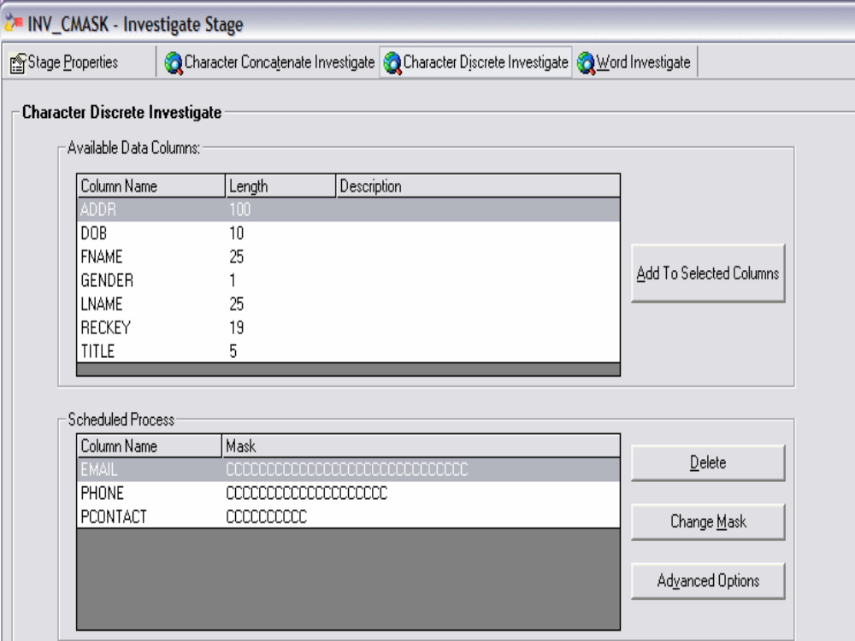

Slide 28
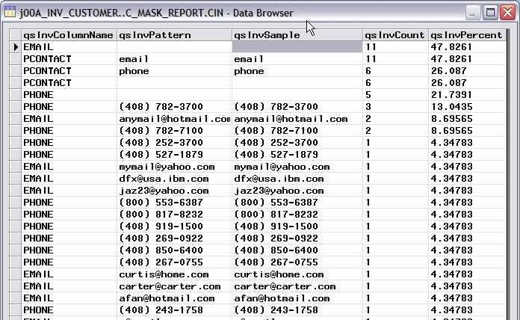

Slide 29
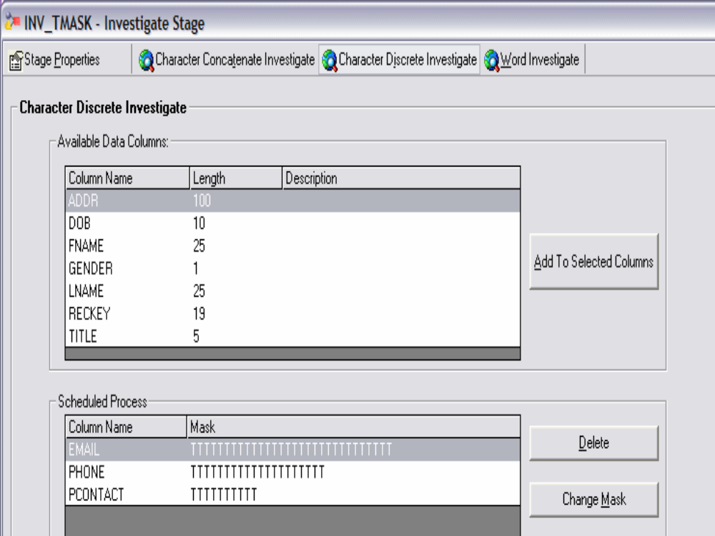

Slide 30
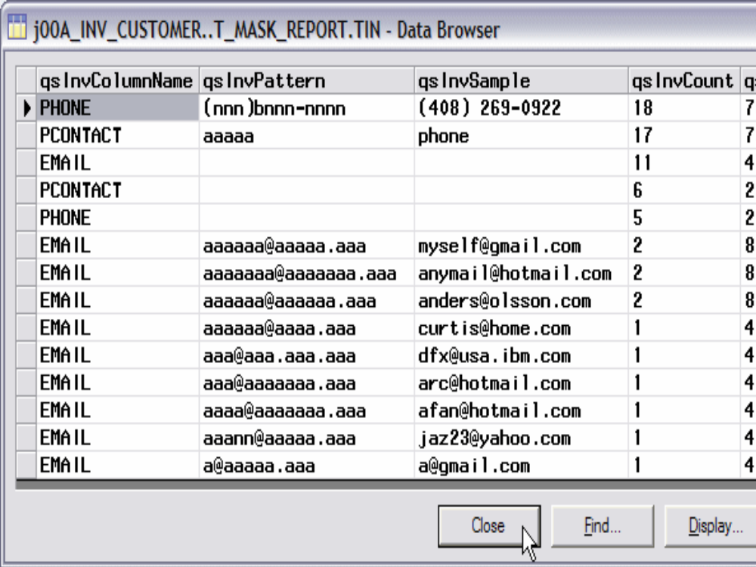

Slide 31
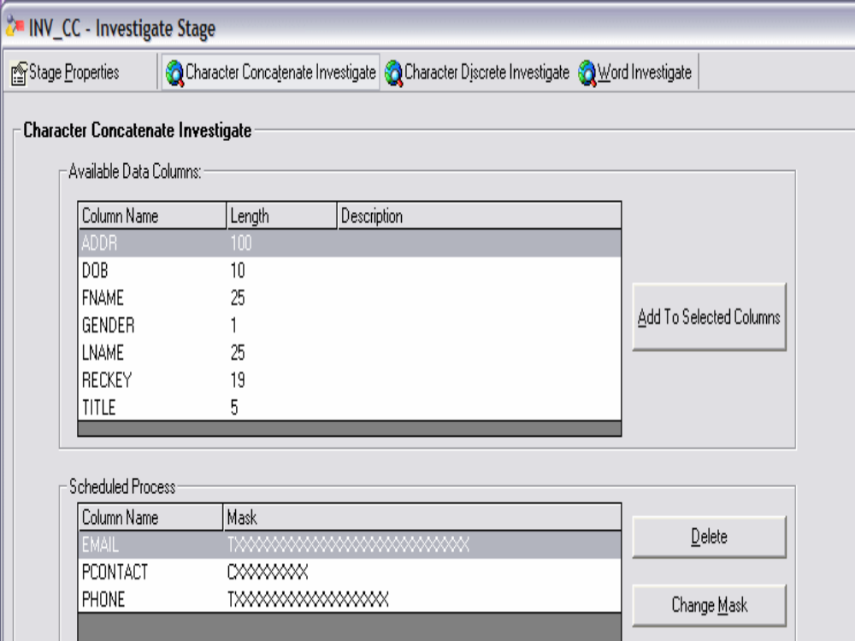

Slide 32
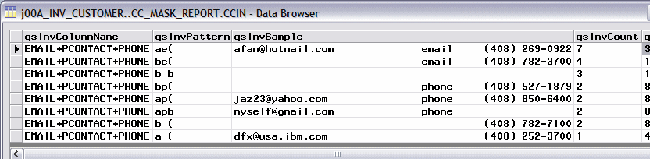

Slide 33
Word Investigation
Transfers free-form data fields into individual tokens and analyzes them to create patterns.
The Investigate stage provides pre-built rule sets for investigating patterns on names and postal addresses for a number of different countries.

Slide 34
Investigate Stage
Class Description
  ^ Numeric containing all digits, such as 1234
  ? Unknown token containing one or more words, such as CHERRY HILL
  > Leading numeric containing numbers followed by one or more letters, such as 123A
  < Leading alpha containing letters followed by one or more numbers, such as A3
  @ Complex mix containing an alpha and numeric characters that do not fit into either of the above classes, such as: 123A45 and ABC345TR
  0 Null
  - Hyphen
  / Slash
  & Ampersand
  # Number sign
  ( Left parenthesis
  ) Right parenthesis
  ~ Special containing special characters that are not generally
  found in addresses, such as !, \, @, ~, %, etc.

Slide 35
The Investigate stage provides pre-built rule sets for investigating patterns on names and postal addresses for a number of different countries.
Eg: USPREP
Name, address, and area data.
USNAME
Individual and organization names.
USADDR
Street and mailing addresses.

Slide 36
SNR GENERATION E
SR GENERATION E
ASOC ORGTYPE E
ASOCS ORGTYPE E
CENTRE CTR M
CNTER CTR M
CNTR CTR M
CTER CTR M

Slide 37
MISS PREFIX E
MR PREFIX E
MRS PREFIX E
BLD BLDG U
BLDG BLDG U
SE SE D
SOUTHEAST SE D 850

Slide 38
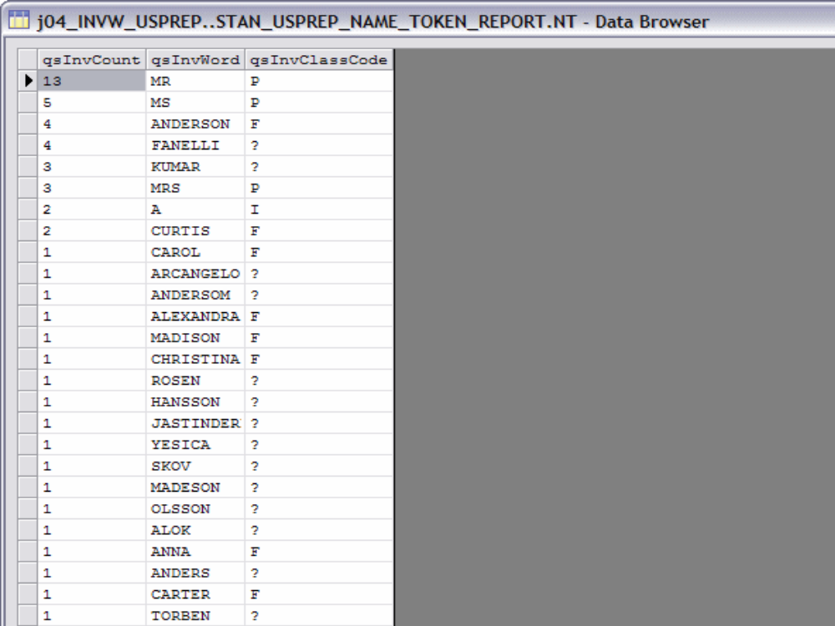

Slide 39
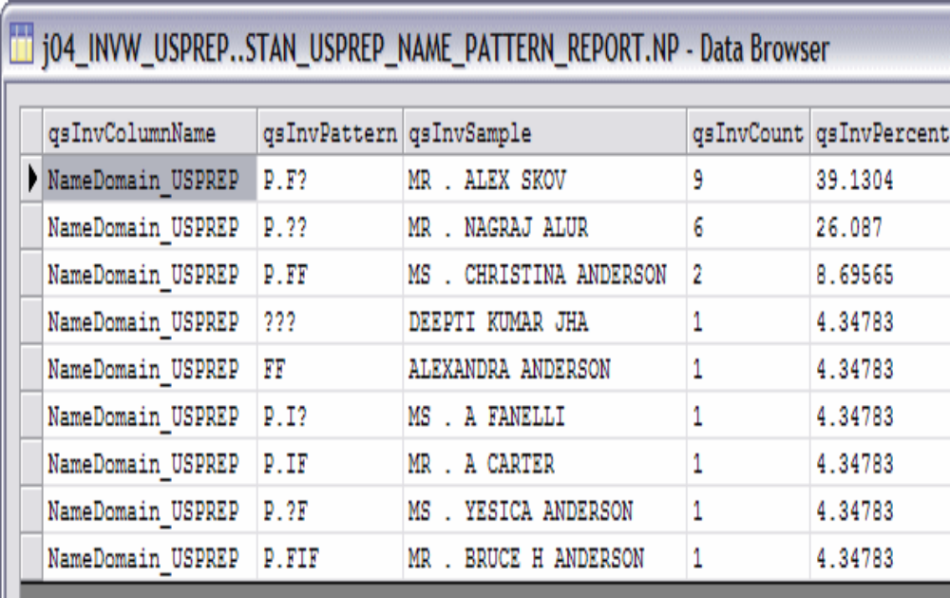

Slide 40
Standardize stage
moves free-form data into fixed format fields.
manipulates data to conform to standard conventions.
Facilitates effective matching
Enables output formatting
Standardize ensures that each data type has the same content and format.

Slide 41
Assign data to its appropriate metadata fields.
Decompose free-form fields into single component fields.
Identify new data fields.
Break up records storing multiple entities.
Exclude records that do not meet minimum criteria.

Slide 42
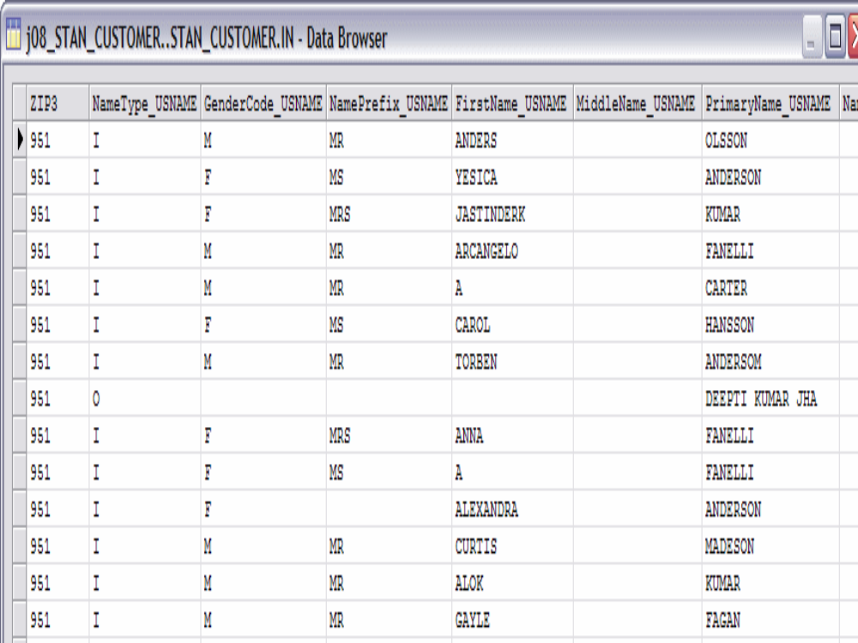

Slide 43
Standardize rule sets
Country Identifier
Domain Pre-processor
Domain specific
Validation

Slide 44
Country Identifier
This rule identify the country and append ISO country code based on address format.
Example
Input Record
100 SUMMER STREET 15TH FLOOR BOSTON,MA 02111
SITE 6 COMP 10 RR 8 STN MAIN MILLARVILLE AB T0L 1K0
28 GROSVENOR STREET LONDON W1X 9FE
123 MAIN STREET

Slide 45
Country Identifier
OUTPUT RECORD
US Y 100 SUMMER STREET 15TH FLOOR BOSTON,MA 02111
CA Y SITE 6 COMP 10 RR 8 STN MAIN MILLARVILLE AB T0L 1K0
GB Y 28 GROSVENOR STREET LONDON W1X 9FE
US N 123 MAIN STREET

Slide 46
Domain preprocessor
These rule sets do not perform standardization but parse the columns in each record and each token into one of the appropriate domain-specific column sets, which are Name, Area, or Address.
Eg:NAME1 John Doe
NAME2 123 Main Street Apt. 456
ADDR1 C/O Mary Doe
ADDR2 Boston, MA 02111
NAME John Doe C/O Mary Doe
ADDRESS 123 Main Street Apt. 456
AREA Boston, MA 02111

Slide 47
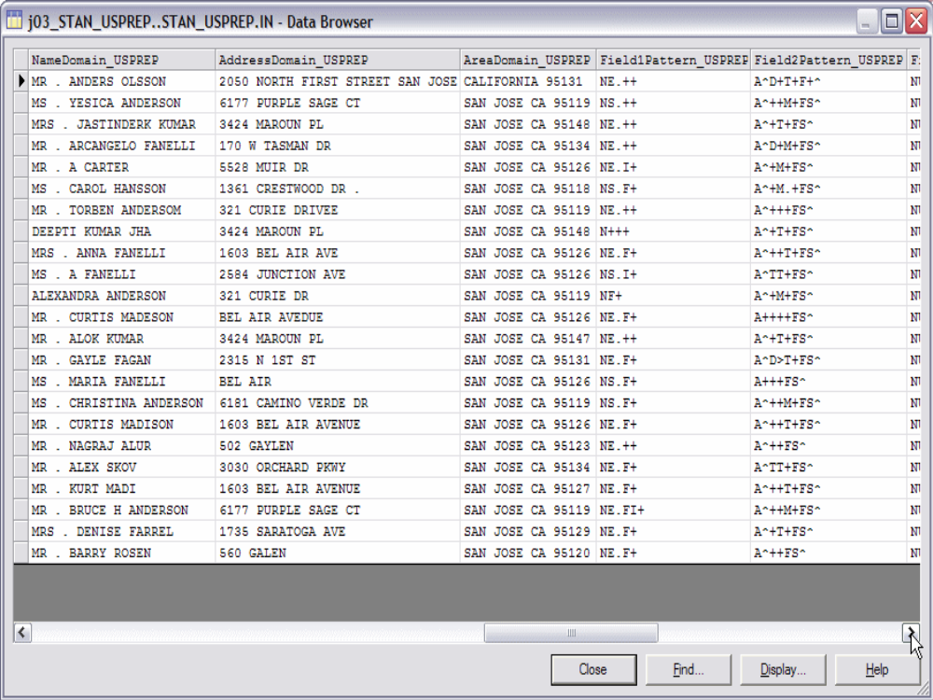

Slide 48
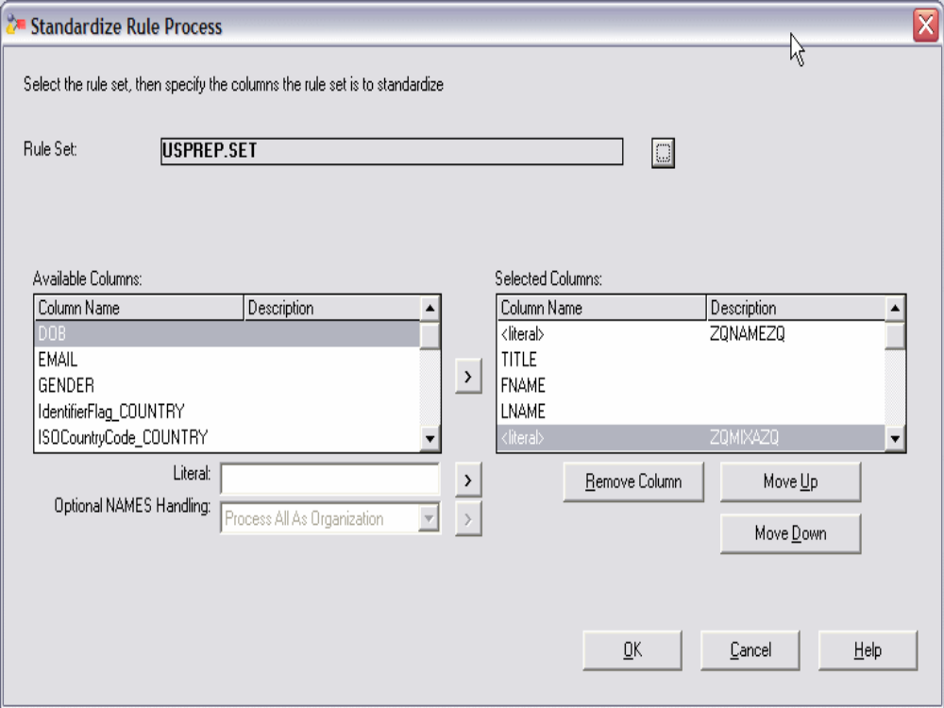

Slide 49
Domain Specific rules
Name including individual names, organization names, attention instructions, and secondary names.
Address including unit number, street name, type, and directionals.
Area including cities, states, region, and other locale information.

Slide 50
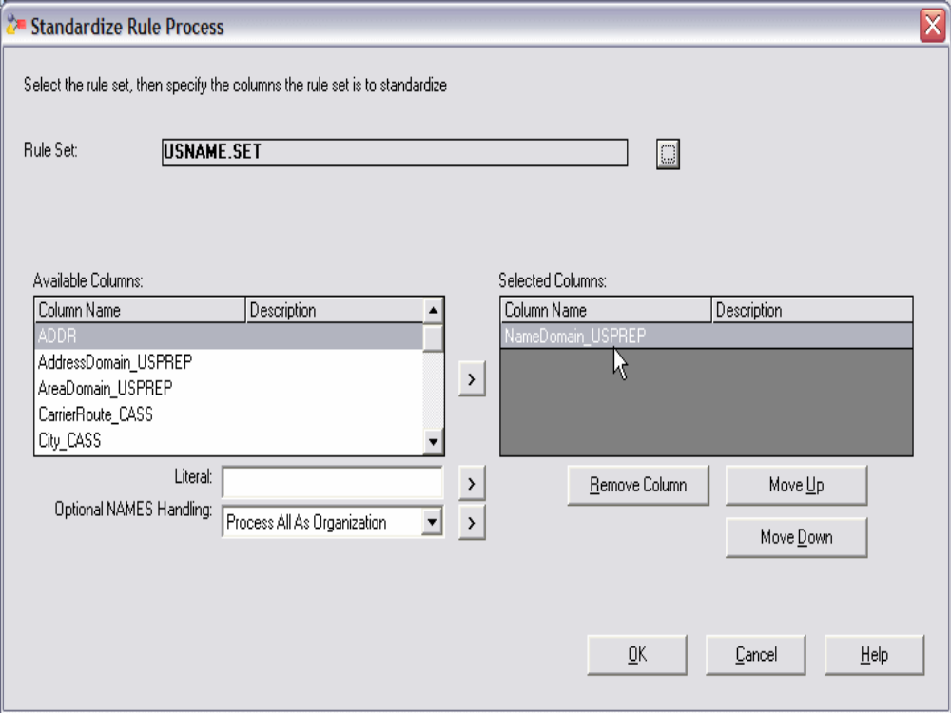

Slide 51
Validation rule set
The Validation rule sets are used to standardize common business data including Date, Email Address, Phone Number, and Taxpayer ID/Social Security Number.
This rule set will produce two types of outputs
One is business intelligence column which will helps to focus on critical information contained with in output data.
Valid data (VD)
Reporting Error

Slide 52
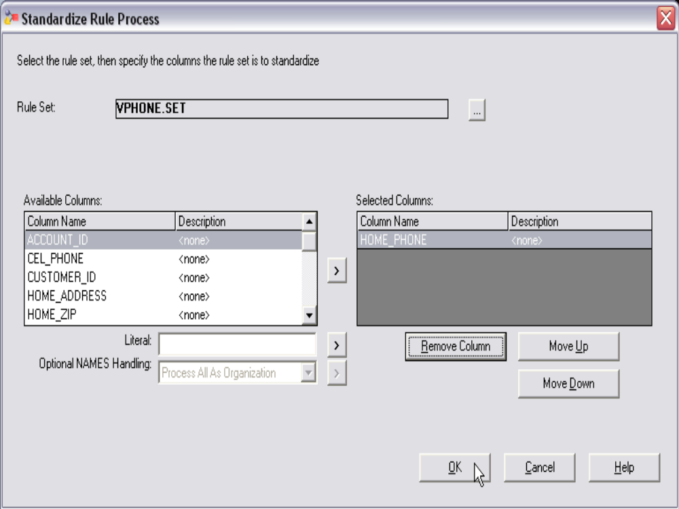

Slide 53
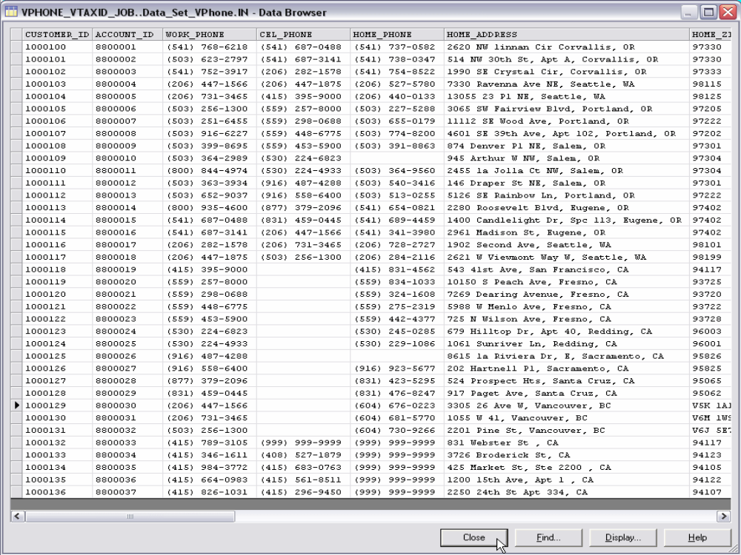

Slide 54
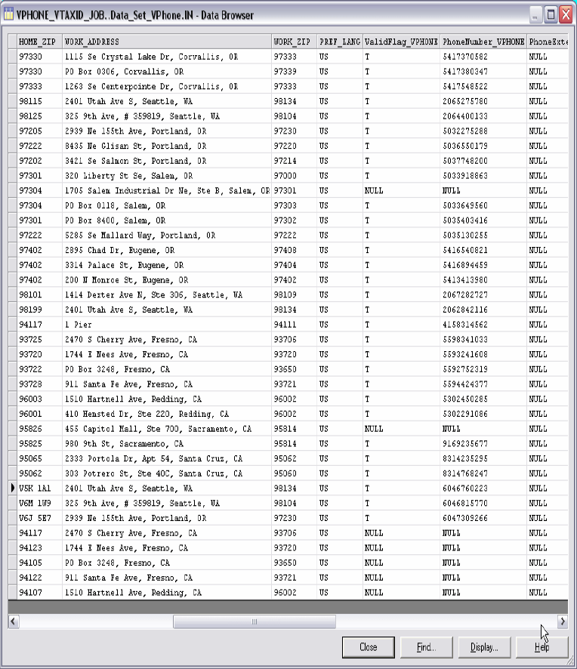

Slide 55
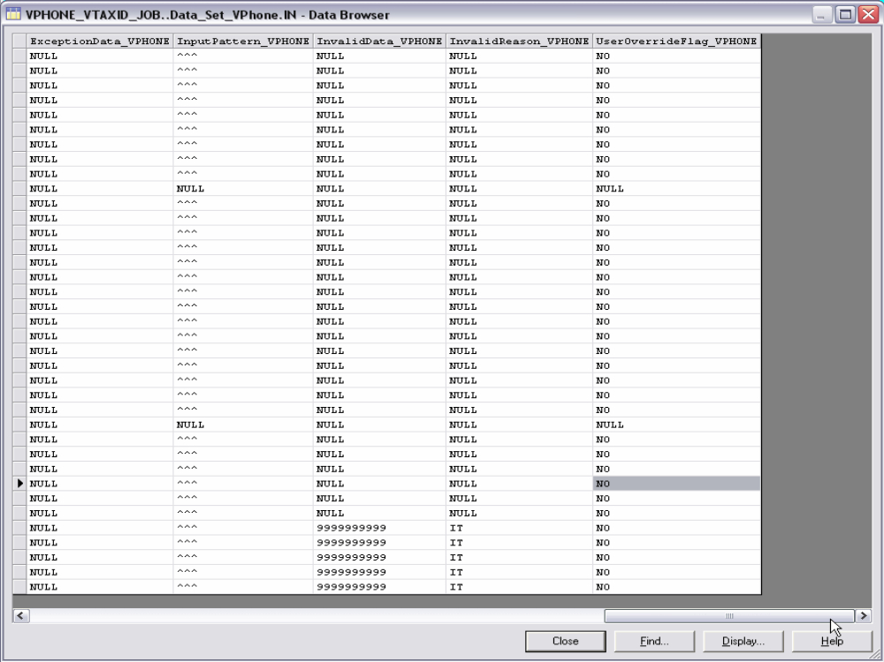

Slide 56
Apply rule set override
Improve the standardization for USNAME
The pattern +FI represents unclassified last name (standard rule set approach),a first name followed by a middle initial
The data appears to have been classified correctly so a classification override will not process this data correctly
The input pattern is identical to the unhandled pattern. This is an indication that the pattern did not match any pattern in the pattern action file and an input pattern override would cause that pattern to be processed
Unhandled Unhandled Data Input Pattern Input Name Text
Pattern
+FI DAMORA WILLIAM H +FI DAMORA WILLIAM H
+FI PEPE NANCY J +FI PEPE NANCY J

Slide 57
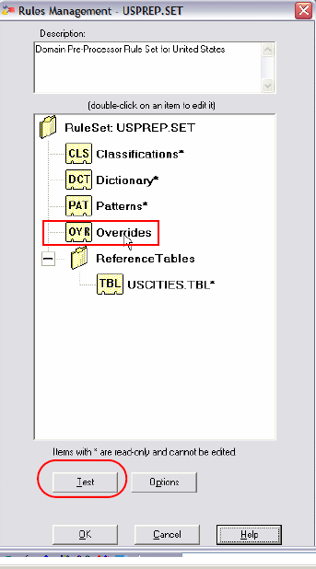
Rules Set Management

Slide 58
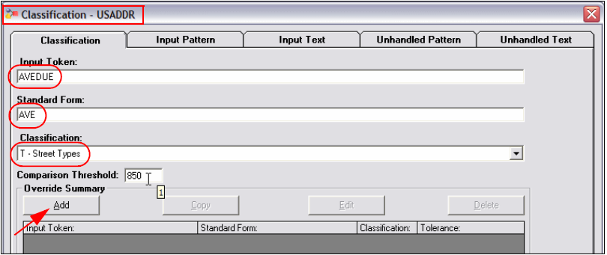
Classification override of AVEDUE input token

Slide 59
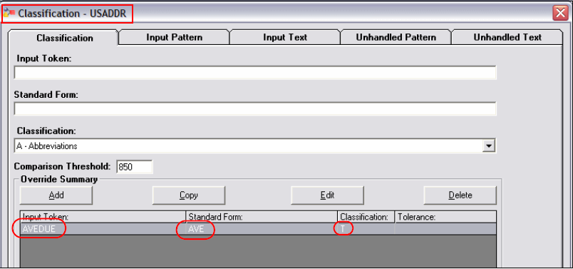
Classification override of AVEDUE input token

Slide 60
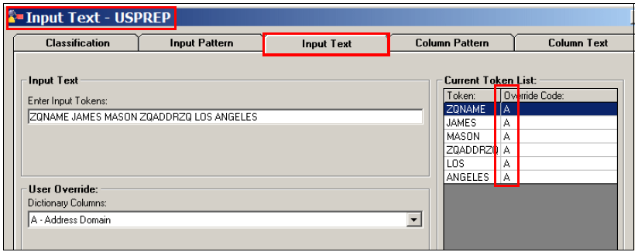
Input text override example

Slide 61
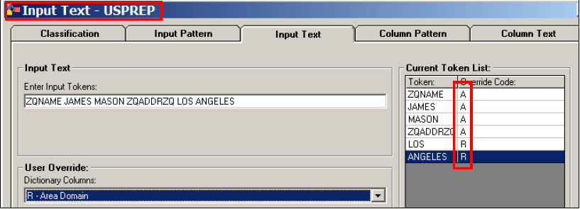
Input text override example

Slide 62
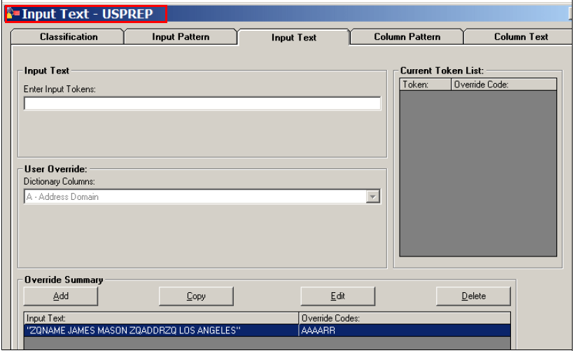
Input text override example

Slide 63
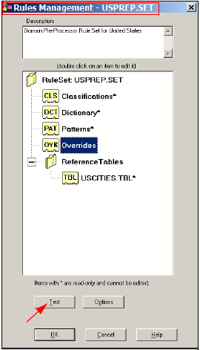
Input text override example

Slide 64
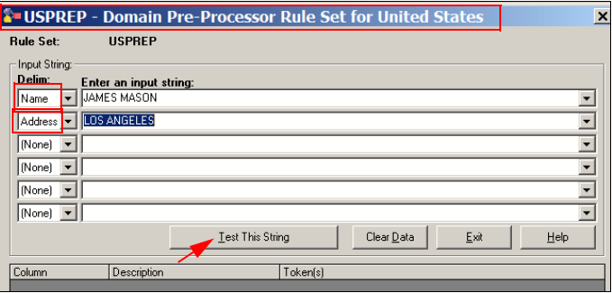
Input text override example

Slide 65
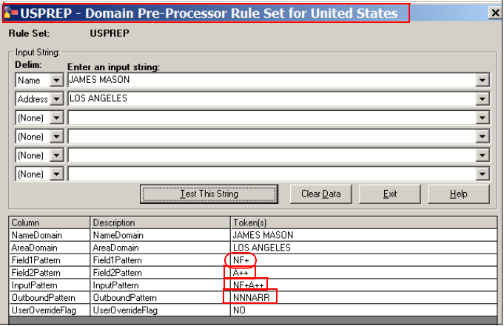
Input text override example

Slide 66
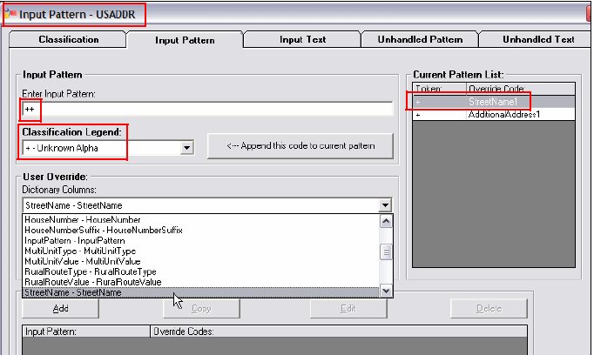
Input pattern override for domain-specific rule set

Slide 67
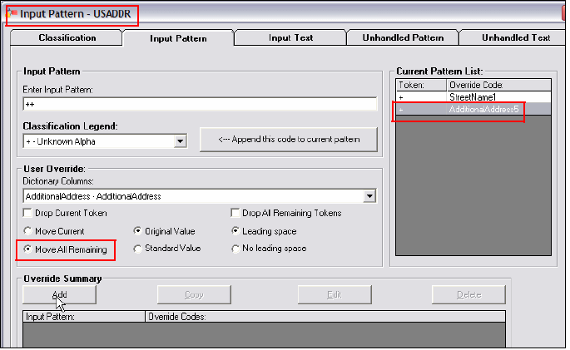
Input pattern override for domain-specific rule set

Slide 68
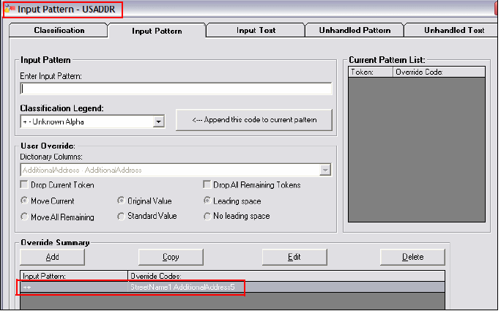
Input pattern override for domain-specific rule set

Slide 69
MATCHING DATA
Data matching finds records in a single data source or independent data sources that refer to the same entity (such as a person, organization, location, product, or material) even if there is no predetermined key.
To increase its usability and completeness, data can be consolidated or linked (matched) along any relationship, such as a common person, business, place, product, part, or event. You can also use matching to find duplicate entities that are caused by data entry violations or account-oriented business practices.

Slide 70
MATCHING DATA
During the data matching stage, IBM WebSphere QualityStage takes the following actions
Identifies duplicate records (such as customers, suppliers, products, or parts) within one or more data sources
Provides householding for individuals (such as a family or group of individuals at a location) and householding for commercial entities (multiple businesses in the same location or different locations)
Enables the creation of match groups across data sources that might or might not have a predetermined key

Slide 71
MATCHING DATA
There are two types of match stage
Unduplicate match :locates and groups all similar records within a single input data source. This process identifies potential duplicate records, which might then be removed
Reference Match identifies relationships among records in two data sources.
An example of many-to-one matching is matching the ZIP codes in a
customer file with the list of valid ZIP codes. More than one record in the customer file can have the same ZIP code in it.

Slide 72
Match stage
Blocking step
Blocking provides a method of limiting the number of pairs to examine. When you partition data sources into mutually-exclusive and exhaustive subsets and only search for matches within a subset, the process of matching becomes manageable.
Basic blocking concepts include:
Blocking partitions the sources into subsets that make computation feasible.Block size is the single most important factor in match performance.Blocks should be as small as possible without causing block overflows. Smaller blocks are more efficient than larger blocks during matching.

Slide 73
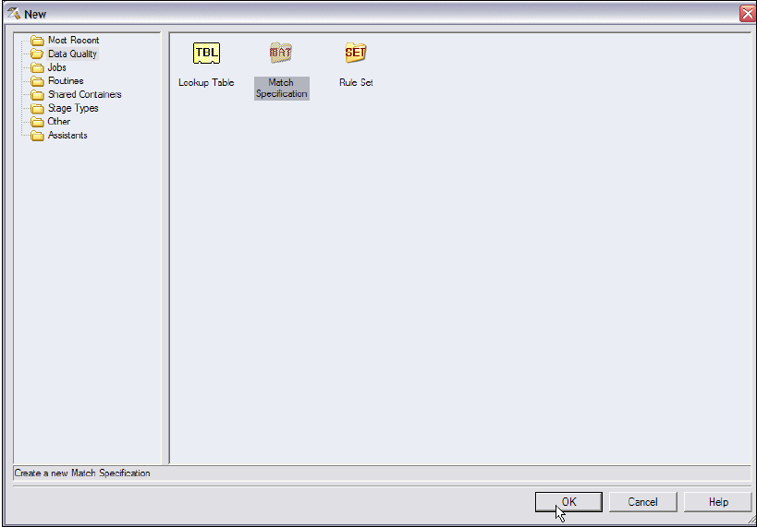
EXAMPLE FOR MATCH STAGE

Slide 74
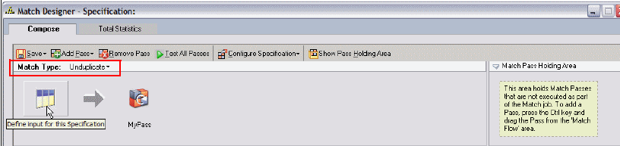

Slide 75
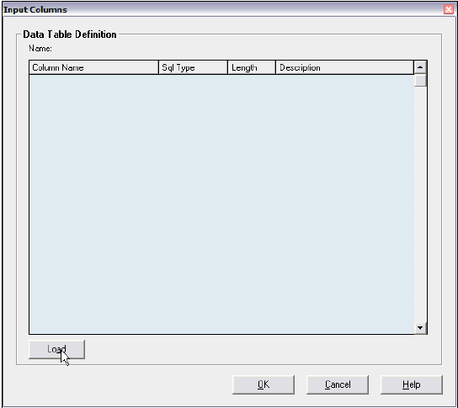
Load the data

Slide 76
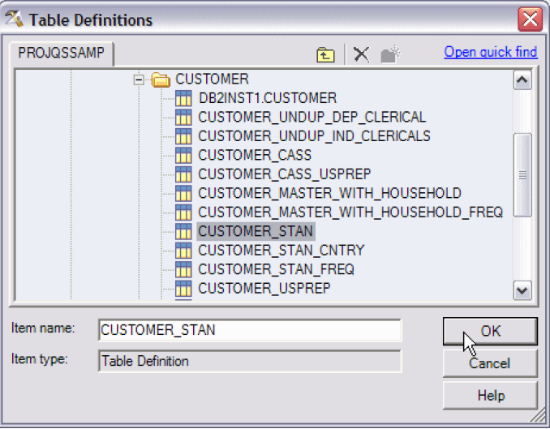
Load Data from Table definitions

Slide 77
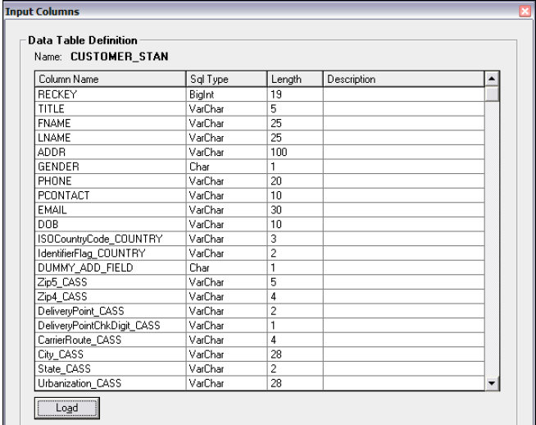

Slide 78
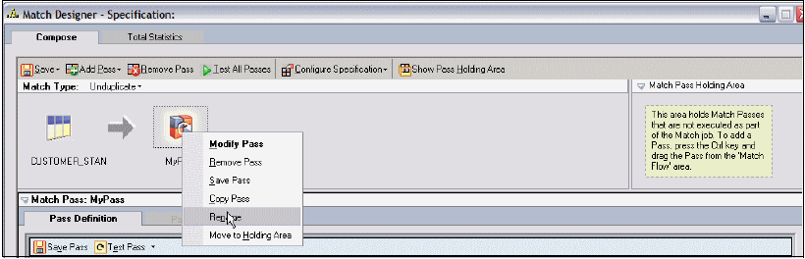
Change the name

Slide 79
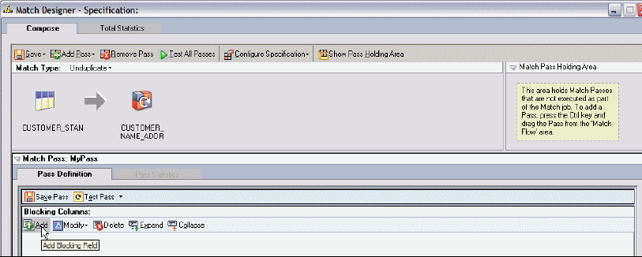
Adding a Blocking Strategy

Slide 80
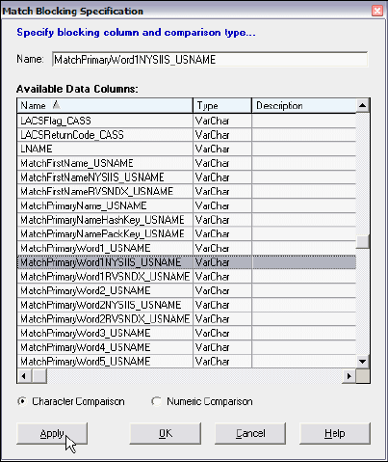

Slide 81
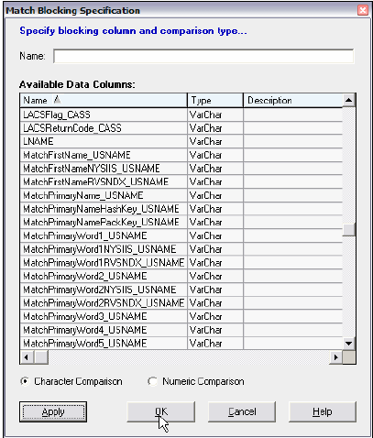

Slide 82
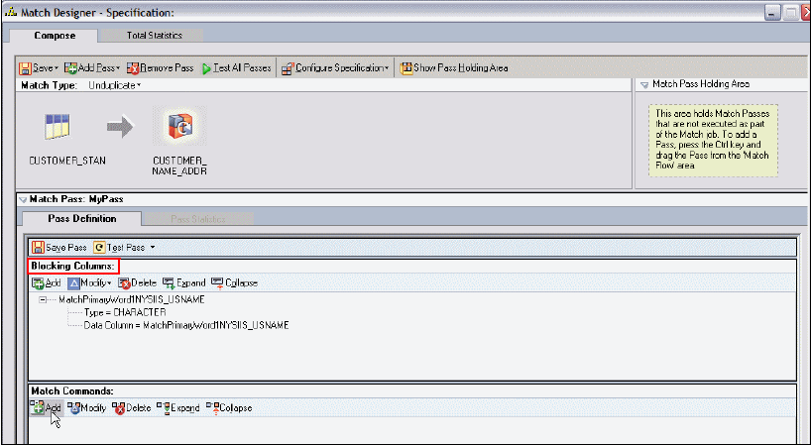
Match Command

Slide 83
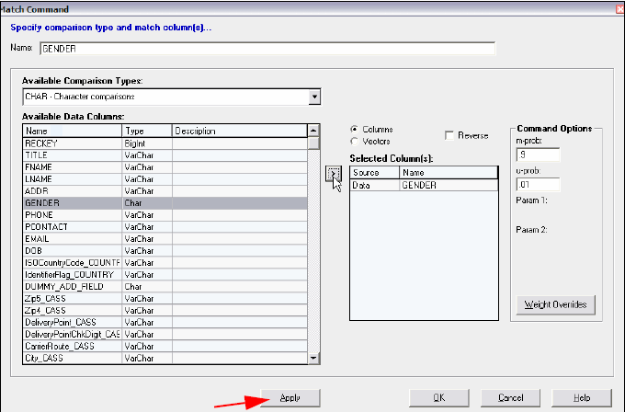

Slide 84
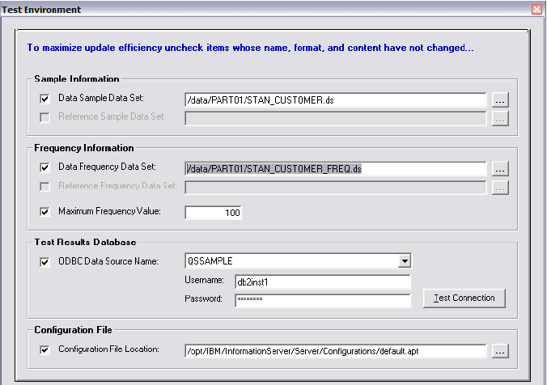
Specify the Test Environment

Slide 85
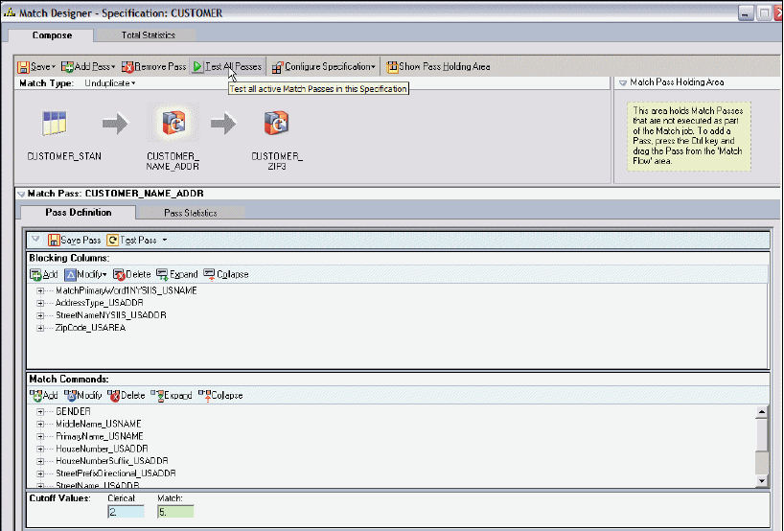

Slide 86


Slide 87


Slide 88


Slide 89
Use restrictive blocking schemes in the first pass with blocking variables (such as SSN) that are expected to match records definitively. Unmatched records can then be subject to less restrictive blocking variables such as first and last name. Thus progressively, fewer and fewer unmatched records can be subject to matching in subsequent passes that have less and less restrictive blocking variables.
The best blocking variables are those with the largest number of values possible and the highest reliability.
Eg: Two data sources containing a date, given name, family name and gender:
Pass 1: date and gender
Pass 2: Soundex of family name and first two characters of given name
Pass 3: Soundex of given name, year and month (from date)

Slide 90
Matching step
Looks for matches in records that have the same values in the blocking columns.
Match stage compares columns that you specified as matching columns to determine the best match for a record.
Calculates a weight for each comparison.
The m probability reflects the error rate for the column.
The u probability.

Slide 91
Match Cutoff threshold
When a record pair receives a composite weight greater than or equal to this weight, the pair is declared a match.
Clerical Cutoff threshold
When a record pair receives a composite weight greater than or equal to this weight and less than the match cutoff, the pair is marked for clerical review.
Duplicate threshold
The lowest weight that a record pair can have to be considered a duplicate.

Slide 92
Match Frequency Stage
Common comparisons
CHAR (character comparison) character by character, left to right.
CNT_DIFF (count differences) tolerates a set number of key stroke errors (typically 1-2) on a prorated basis.
DATE8 (basic tolerance of date errors) tolerates a set number of variations in days on a prorated basis.
PREFIX - (shortest value character comparison) character by character, left to right to a maximum of the shortest value length
Where mostly used
This is most useful to ensure a direct comparison, particular on code related fields such as Gender.
This is most commonly used with data such as telephone number or SSN where there is higher probability of key stroke issues.
This is most commonly used with data such as date of birth, date of encounter, and so forth where there is possibility of slight error in the day entered.
This is most useful to ensure matching of truncateddata such as middle initial.

Slide 93


Slide 94


Slide 95


Slide 96


Slide 97
Reference Match Stage
The Reference Match stage identifies relationships among records. This match can group records that are being compared in different ways as follows:
One-to-many matching
Many-to-one matching

Slide 98
One-to-many matching
Reference Match
Identifies all records in one data source that correspond to a record for the same individual, event, household, or street address in a second data source.
Only one record in the reference source can match one record in the data source because the matching applies to individual events.
Eg: finding the same individual based on comparing SSN in voter registration list and department of motor vehicles list.

Slide 99
Many-to-one matching
Multiple records in the data file can match a single record in the reference file.
Eg: matching a transaction data source to a master data source allows many transactions for one person in the master data source.

Slide 100
The Reference match stage delivers up to six outputs as follows:
– Match contains matched records for both inputs
– Clerical has records that fall in the clerical range for both inputs
– Data Duplicate contains duplicates in the data source
– Reference Duplicate contains duplicates in the reference source
– Data Residual contains records that are non-matches from the data input
– Reference Residual contains records that are non-matches from the reference input

Slide 101


Slide 102

Reference Match Example

Slide 103


Slide 104


Slide 105
WAVESSTAGE
IBM WebSphere QualityStage Worldwide Address Verification and Enhancement System (WAVES) enables users to standardize, verify, and correct extensive, multinational address data against postal reference files for better data integration and customer communication worldwide.
The WAVES stage provides the following processing to the input data
Corrects typographical and spelling errors in the input data.
Matches a corrected input address against an address in a country-specific postal reference file by using probabilistic matching.
Assigns the postal record data to the appropriate field in the output file and substitutes the erroneous and missing input data with the verified postal data. Appends the verified record to the original record.

Slide 106
MNS STAGE
The Multinational Standardize stage (MNS) standardizes and verifies
international address data.
The MNS stage uses country names, abbreviations, or ISO country codes in the input file to apply country-appropriate standardization rules.
Thus, you can standardize all the records without having to consolidate records from each country into separate files and to standardize the records using country-specific rule sets.
For most countries, the MNS stage does the following tasks:
Separates street-level address information from city-level information
Assigns city, locality, province/state, postal code, and postal code add-on to separate fields
Assigns ISO country codes (2- and 3-byte versions)
Assigns city name phonetics with enhanced New York State Information and Intelligence Systems (NYSIIS) and reverse Soundex to match incorrectly spelled city names

